Slide 1
Introduction of SQL DML Commands
BY GURUNATH DML
BY RAHUL VIEW
BY Preshita VIEW

Slide 2
DML Commands
SELECT
INSERT
UPDATE
DELETE

Slide 3

introduction
DML stands for ''data manipulation language. '' It's a set of SQL statements that act on the data within a table. Select, insert, update, and delete are elements of this language. You'd use these elements when you want to retrieve a portion of, add data to, change data within, or delete data from a table..​
20XX
presentation title

Slide 4
SELECT
SELECT command or statement in SQL is used to fetch data records from the database table and present it in the form of a result set. It is usually considered a DQL command, but it can also be considered a DML.
SELECT customerName, phone, city,state FROM customers;

Slide 5
INSERT
INSERT commands in SQL are used to insert data records or rows in a database table. In an INSERT statement, we specify both the column_names for which the entry has to be made along with the data value that has to be inserted.
INSERT INTO table_name (column1, column2, column3, ...)
VALUES (value1, value2, value3, ...);
20XX
presentation title

Slide 6
UPDATE
UPDATE command or statement is used to modify the value of an existing column in a database table.
UPDATE table_name
SET column1 = value1, column2 = value2, ...
WHERE condition;
DELETE
DELETE statement in SQL is used to remove one or more rows from the database table. It does not delete the data records permanently. We can always perform a rollback operation to undo a DELETE command. With DELETE statements, we can use the WHERE clause for filtering specific rows.
DELETE FROM table_name WHERE condition;
20XX
presentation title

Slide 7
View
A view is a database object that has no values. Its contents are based on the base table It contains rows and columns similar to the real table.
View is a virtual table created by a query by joining one or more tables.
20XX
presentation title

Slide 8
Create view:
Syntax:
CREATE [OR REPLACE] VIEW view_name AS
SELECT columns
FROM tables
[WHERE conditions];

Slide 9
Updating a View
Unlike CREATE VIEW and DROP VIEW there is no direct statement to update the records of an existing view.
We can use the SQL UPDATE Statement to modify the existing records in a table or a view.
UPDATE view_name
SET column1 = value1, column2 = value2...., columnN = valueN
WHERE [condition];
The SELECT clause may not contain the keyword DISTINCT.
The SELECT clause may not contain summary functions.
The SELECT clause may not contain set functions.
The SELECT clause may not contain set operators.
The SELECT clause may not contain an ORDER BY clause.
The FROM clause may not contain multiple tables.
The WHERE clause may not contain subqueries.
The query may not contain GROUP BY or HAVING.
Calculated columns may not be up

Slide 10

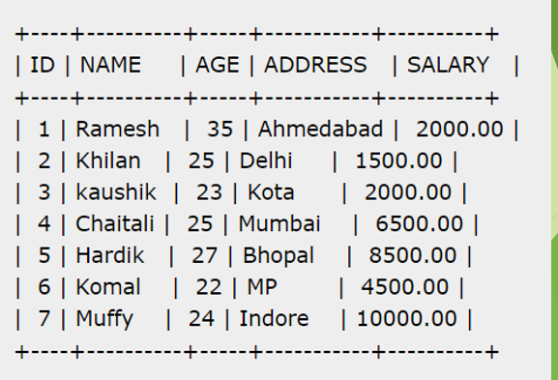
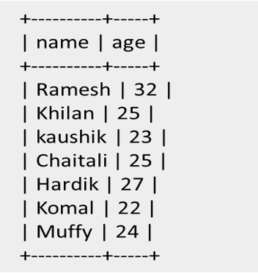
Updating a View

Slide 11
Dropping Views
Obviously, where you have a view, you need a way to drop the view if it is no longer needed. The syntax is very simple and is given beloW
Syntax
DROP VIEW view_name;

Slide 12

Renaming a View
The RENAME TABLE statement in MySQL database is used to rename views.
You just have to make sure that the new name of the view does not overlap with the name of any existing views.
Syntax
RENAME TABLE old_view_name to new_view_name

Slide 13
Thank You
20XX
presentation title

